Slide 1
Metrics Mobile
gives you unparalleled insight into what your code does in mobile

Slide 2
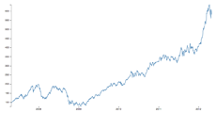


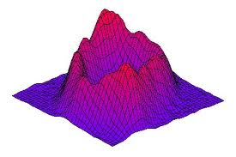








Propose
Monitor System
Control
Metrics
Tunnel Server
Metrics Lib
Data
Analysis System
Collect Data
User Action Info
App Status
Customize
Full Optimize for
WLan Network
Mobile
Cloud Service
Tunnel For Anything
Aggregation
Control Mobile

